Slide 1






Detecting Spam Emails
Student Details
Name: R.Dharnish Krishnan
NM Id: au61772111018
College Name: GOVERNMENT COLLEGE OF ENGINEERING, SALEM

Slide 2
Disclaimer
The content is curated from online/offline resources and used for educational purpose only

Slide 3

Course Outline
Abstract
Problem Statement
Aims, Objective & Proposed System/Solution
System Deployment Approach
Model Development & Algorithm
Future Scope
Video of the Project
Conclusion
Reference

Slide 4


Abstract
Email spam continues to be a pervasive issue, causing inconvenience and potential harm to users. In this project, we propose a machine learning approach to automatically detect spam emails. The project involves collecting a dataset of labeled emails, where each email is classified as spam or non-spam (ham). The project aims to develop a robust and efficient spam detection system that can be deployed to protect users from unwanted and potentially harmful emails.

Slide 5


Problem Statement
Detecting Spam Emails Using TensorFlow. Implement and build a deep-learning model for Spam Detection. The model we will try to implement will be a Classifier, which would give binary outputs- either spam or ham.

Slide 6

Aim and Objective
Aim: This project aims to develop an effective spam email detection system using machine learning techniques. The project will involve collecting a dataset of labeled emails, preprocessing the email text data, extracting relevant features, and training a machine learning model to classify emails as spam or non-spam (ham).

Slide 7
Objectives
Collect a dataset of labeled emails, including spam and non-spam (ham) emails.
Preprocess the email text data to prepare it for machine learning model training.
Extract relevant features from the email text data using techniques such as TF-IDF and N-grams.
Train a machine learning model, such as a Naive Bayes classifier or a Support Vector Machine (SVM), using the extracted features.
Evaluate the performance of the trained model using metrics such as accuracy, precision, recall, and F1 score..
Develop a user-friendly interface for the spam detection system, allowing users to easily classify emails as spam or non-spam.

Slide 8

Proposed Solution
Solution: Gather a dataset of labeled emails, where each email is labeled as spam or non-spam (ham). Preprocess the text data to convert it into a format suitable for machine learning models. This may include removing stop words, tokenization, and converting text to numerical representations. Extract features from the preprocessed text data. Common features include word frequency, TF-IDF (Term Frequency-Inverse Document Frequency), and N-grams. Choose a machine-learning model for spam detection. Common models include logistic regression, support vector machines (SVM), and naive Bayes classifiers.
Notes:
8

Slide 9
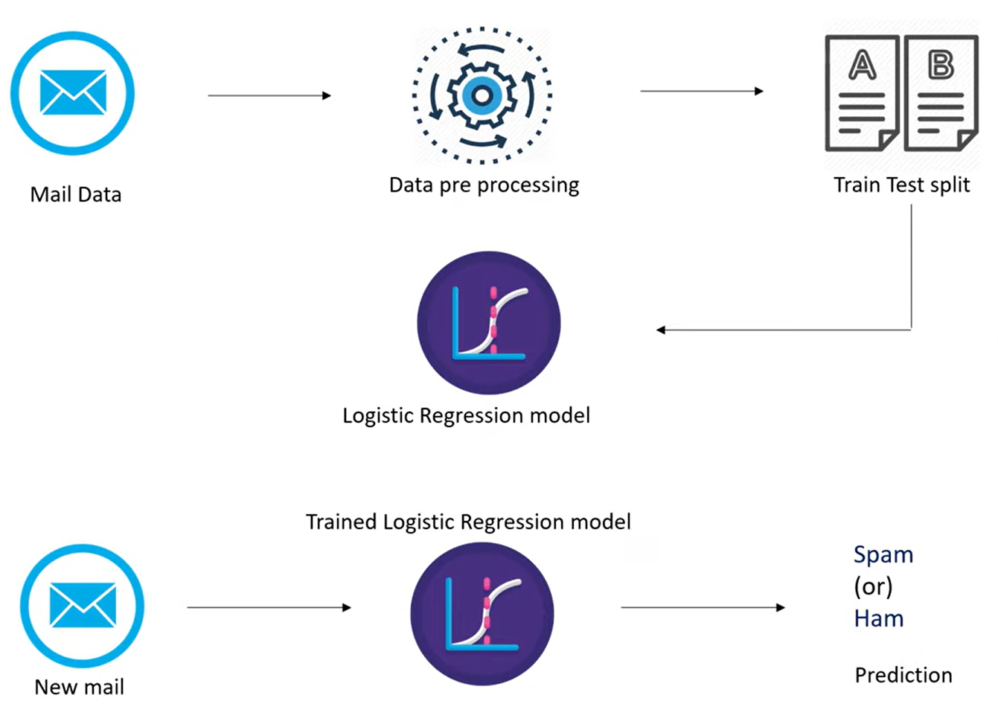
System Deployment Approach
Notes:
9

Slide 10
Model Development & Algorithm
Dataset Description:
The dataset contains set of Emails.
Size of dataset is 5572 rows
Categorized into two classes
Spam, Ham
Each class has around 2780 sentences
Notes:
10

Slide 11
Model Development & Algorithm
Algorithm:
Input: Email text data
Output: Spam or non-spam (ham) classification
Algorithm Steps:
Preprocess the email text data (e.g., remove stop words, tokenize).
Extract features from the pre-processed text data (e.g., TF-IDF, N-grams).
Train a machine learning model on the extracted features (e.g., logistic regression, SVM, naive Bayes).
Evaluate the trained model on a test dataset using metrics such as accuracy, precision, recall, and F1 score.
Fine-tune the model by experimenting with different preprocessing techniques, feature extraction methods, and model parameters to improve performance.
Deploy the trained model as a spam detection system for real-world use.
Notes:
11

Slide 12
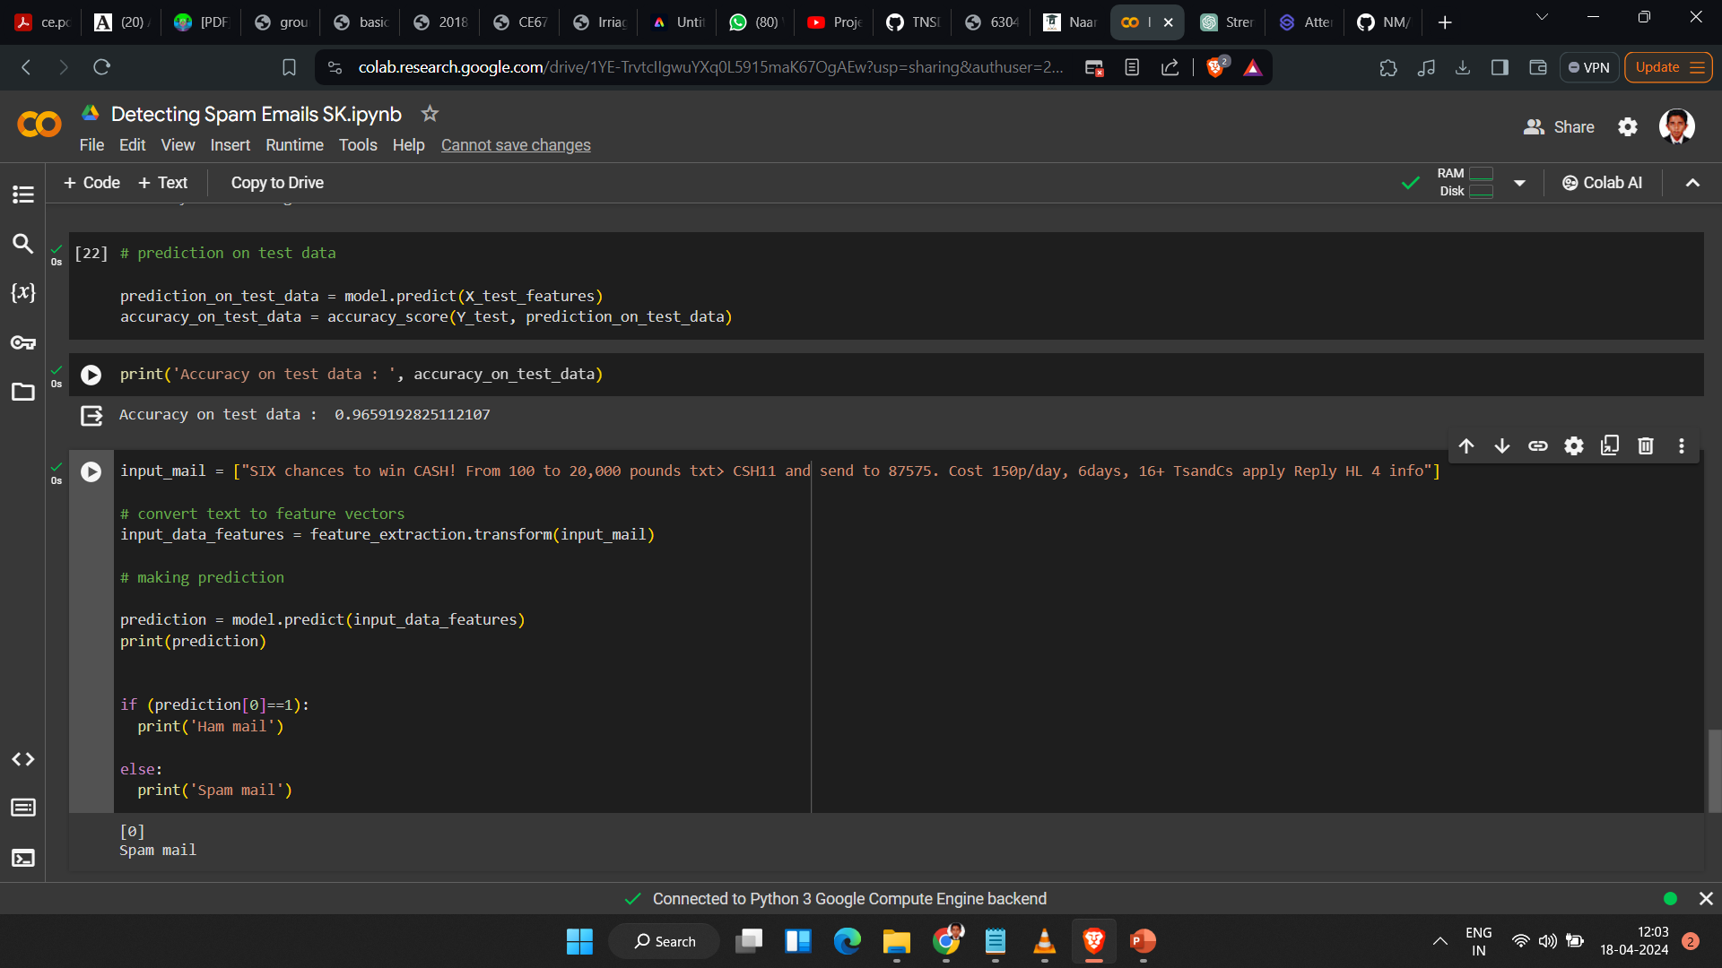
Result
Notes:
12

Slide 13

Future Scope
Advanced Machine Learning Techniques: Explore advanced machine learning techniques such as deep learning, ensemble methods, and natural language processing (NLP) to improve the accuracy and efficiency of spam email detection.
Real-Time Detection: Develop real-time spam detection systems that can quickly identify and filter out spam emails as they are received, providing users with immediate protection.
User Feedback Integration: Incorporate user feedback into the spam detection system to continuously improve its performance and adapt to new spamming techniques.
Multimodal Detection: Combine text-based features with other modalities such as images and metadata to improve the detection of sophisticated spam emails.
Notes:
13

Slide 14
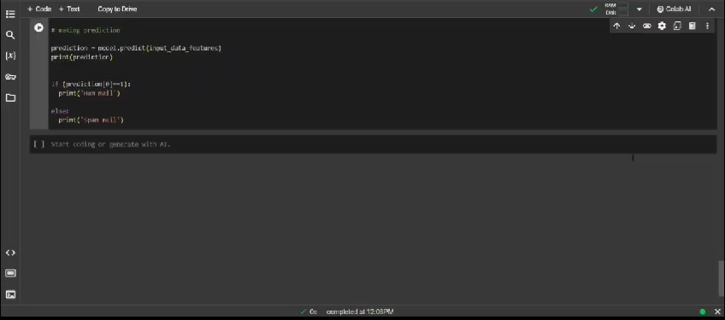
Video of the Project
Notes:
14

Slide 15

Conclusion
In conclusion, our project on spam email detection using machine learning techniques has shown promising results in automatically identifying and filtering out unwanted emails. By leveraging machine learning models such as logistic regression, support vector machines (SVM), and naive Bayes classifiers, we could effectively classify emails as spam or non-spam (ham).
Moving forward, there is potential to enhance this system by exploring advanced machine learning techniques, implementing real-time detection, and incorporating user feedback. These improvements could further enhance the accuracy and efficiency of spam email detection systems, ultimately improving user experience and security.
Notes:
15

Slide 16
Reference
https://www.coursera.org/
https://www.udacity.com/
https://www.kaggle.com/learn
https://codelabs.developers.google.com/
Notes:
Reference
These are the references for this session.

Slide 17
Thank you!
Notes:
17

